Slide 1
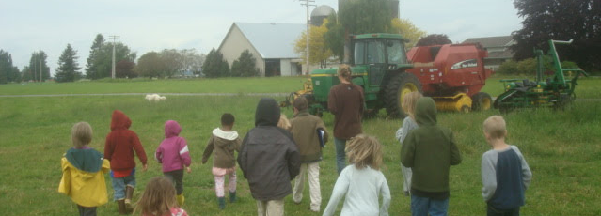


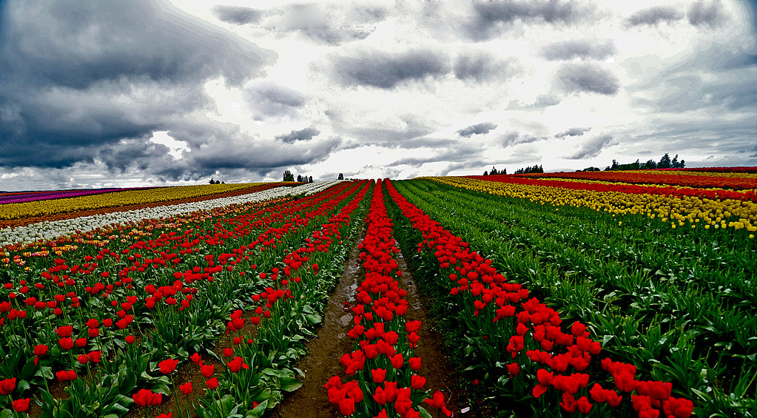
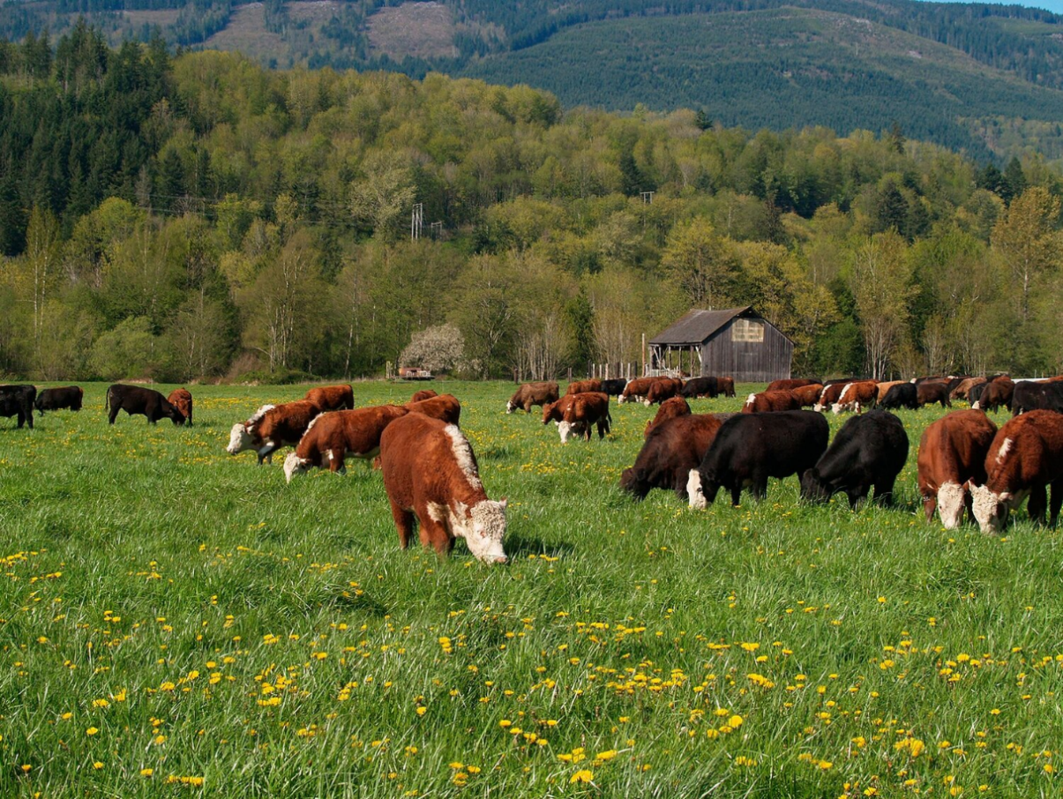
Update
December 13, 2022
Notes:
Peter

Slide 2
Process/Timeline Agritourism
Discovery
(Fall – Winter 2022)
Policy Concepts
(Winter 2023)
Legislative
(Winter-Spring 2023)
Code
Survey
Smaller Meetings
Comp Plan
Multiple Options
Public Forum

Slide 3
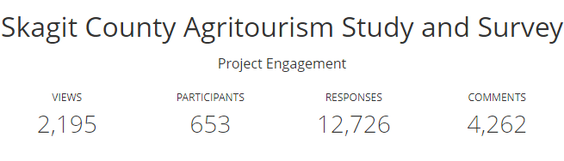

Slide 4
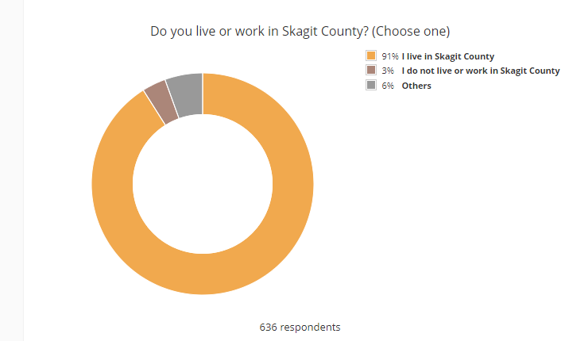

Slide 5
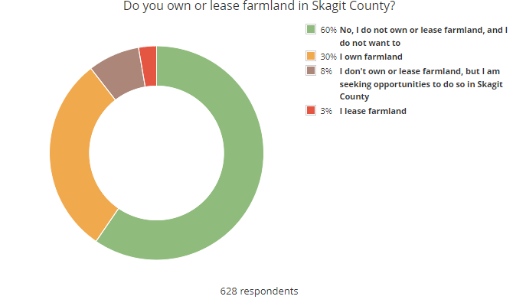

Slide 6
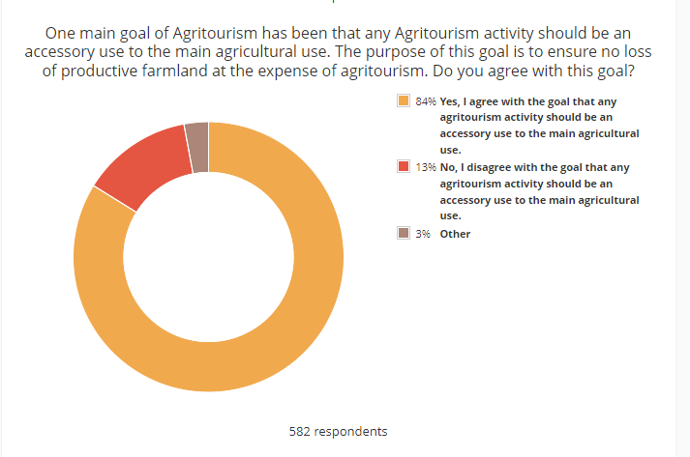

Slide 7

Ag. Leaders Lunch 11/2
Approximately 10-15 attendees
A discussion of how do you define Agritourism and how can agriculture benefit.
A discussion of what is an accessory use- how does agritourism activity (maintain) subordinate use
Timeframe (taking into consideration weather windows needed for harvest)
Actual vs perceived impacts – do we have data?
Desire for an Agriculture Education Foundation and desire for the public to learn about agriculture through agritourism

Slide 8
Sedro Woolley Senior Center 11/10
Approximately 10-12 attendees
A discussion of what agritourism “fits” and how do you keep it accessory
A desire for consistency, safety and enforcement of future activities
Weddings are not agritourism, also can number of wedding operators be limited?
Property rights
The issue of spraying farms is covered by the right to farm ordinance
Define limits- we need a balance

Slide 9
Maple Hall, La Conner 11/16
Approximately 30 attendees
What kind of agritourism should be allowed- think about return on investment.
Farm to table restaurant can showcase what is grown here.
Small farms need support – farm stands and other agritourism help support small farms
Example of Maryland Wholesale Produce Market
Comments in favor of property rights
Regulations need to be flexible as agritourism is evolving
Work with generational farmers cooperatively

Slide 10
Town Hall 12/06
Approximately 50 attendees
On TV 21
There will be a transcript
5 panelists
  Jessie Anderson – Maplehurst Farm
  Terry Sapp – Skagit Agricultural Advisory Board Member
  Leo Roozen – Roozengaarde
  Annie Lohman - Lohman Farms
  Andrea Xaver – Producer Big Lake

Slide 11

Comments/Questions?
Sarah Ruether, Planning & Development Services sruether@co.skagit.wa.us
Lisa Grueter
Lisa@berkconsulting.com

